Slide 1
Operating Systems
1. Introduction
1-Introduction
1

Slide 2
Operating System Services
2

Slide 3
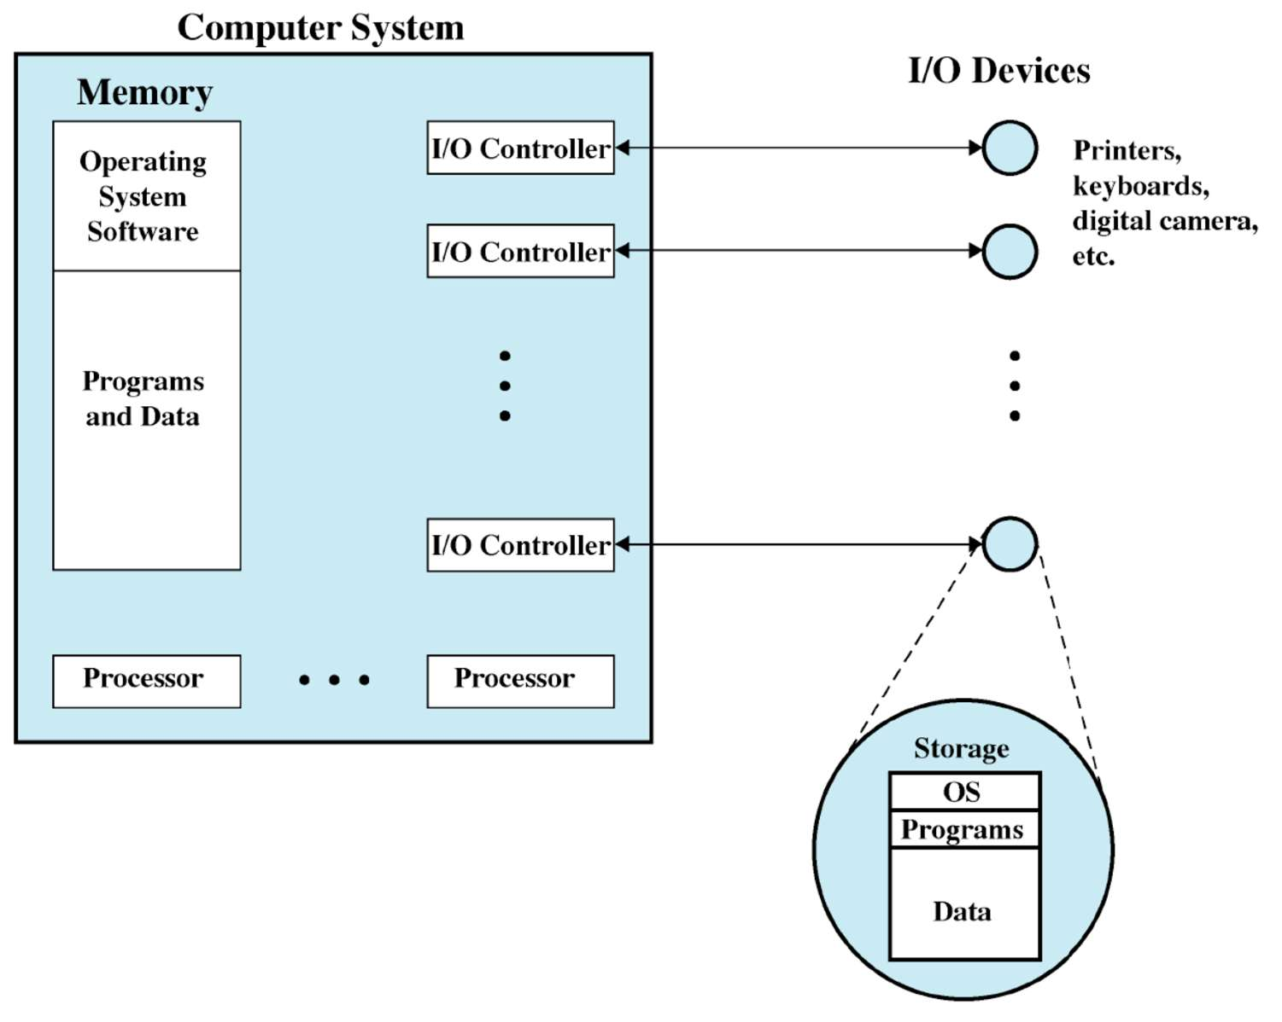
Operating System: … It is a Program …
Relinquishes control of the processor to execute other programs
OS Kernel
(Roughly) Portion of OS that is in main memory
Contains most- frequently used functions
2

Slide 4
Operating System in Action
OS is a program, just like any other program
On computer start, bootstrap program is loaded from ROM
Boot program activates OS kernel (permanent system process)
Shell (is not kernel): Program to let the user initiate processes
Boot program
Examine/check machine configuration, e.g.,
Number of CPUs
How much memory
Number and type of HW devices
Build configuration structure describing the HW
Locates and Loads the OS
The control transfers to the OS
2

Slide 5
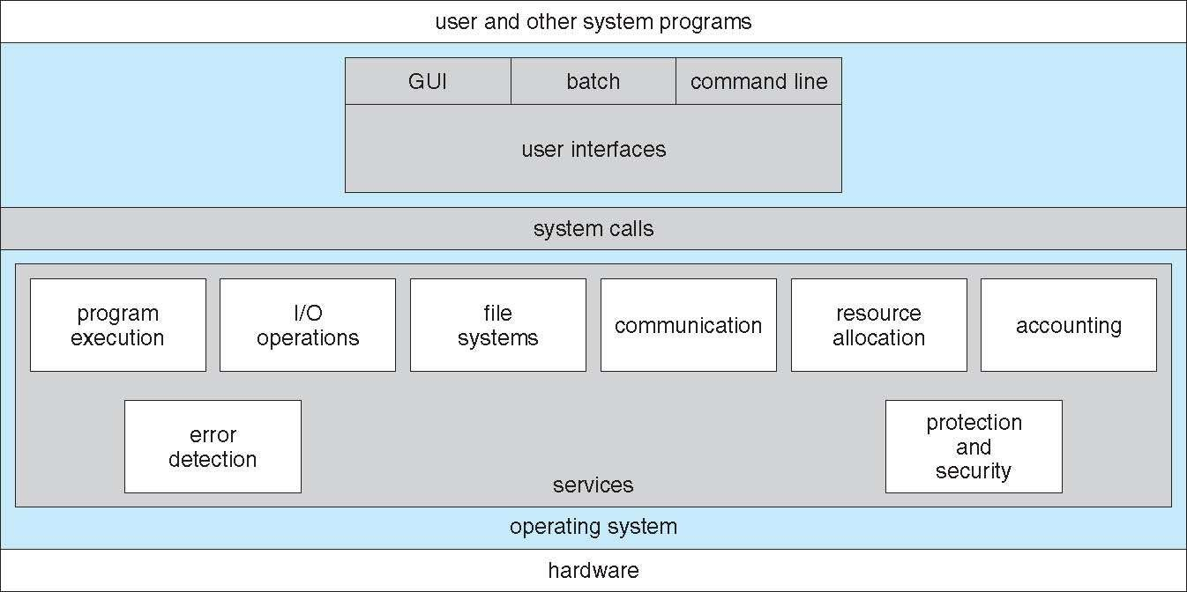
Operating System Services
2

Slide 6
Operating System Services – Helper
User interface
Command line
Shell provides command line interface
cat file1 file2 file3 | sort > text.txt &
Create two processes cat, sort and links input/output
Graphical user interface
Batch interface
Commands are entered into files and those files are executed
Program execution
Load program into memory and run it
End execution either normally or abnormally
2

Slide 7
Operating System Services – Helper
I/O operations
User programs cannot control I/O device directly
Operating system must provide some means to control I/O
File system manipulation
Program’s capability to read, write, create or delete files or directories
Permission management to allow or deny access to files or directories
Communication
Exchange of information between processes
Processes may be executing on different computers via network
Communication on same computer via shared memory or message passing
2

Slide 8
Operating System Services – Helper
Error detection
OS needs to be constantly aware of possible errors
May occur in CPU & memory hardware, in I/O device, in user program
OS takes corrective actions to ensure correct computing
Debugging facilities to the application programmers
2

Slide 9
Operating System Services – Efficient Operations
Resource allocation
Resource allocation to concurrently running jobs
Resources such as CPU cycles, main memory, file storage etc.
Accounting
Track usage of computer resources
For billing or simply for accumulating usage statistics
Protection and security
Protect access to system resources is controlled
Security from the outsiders, e.g., user authentication
2

Slide 10
System Calls
10

Slide 11
System Calls
Programming interface to the services provided by the OS
Typically written in a high-level language (C or C++)
Mostly accessed by programs via a high-level Application Program Interface (API) rather than direct system call use
Three most common APIs
Win32 API for Windows
POSIX API for POSIX-based systems
Virtually all versions of UNIX, Linux, and Mac OS (X)
Java API for the Java virtual machine (JVM)
Why use APIs rather than system calls?
11

Slide 12
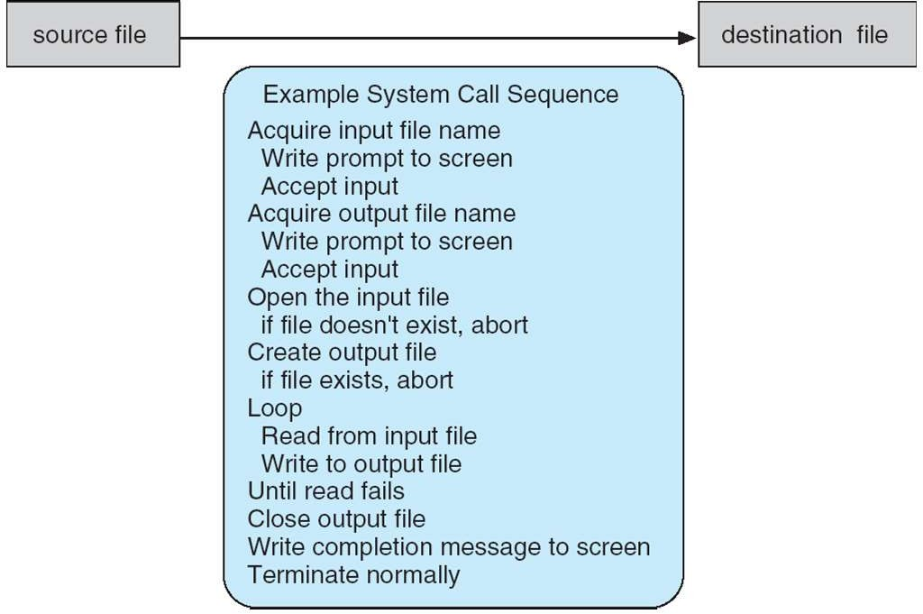
System Call – Example
Copy the contents of one file to another file
12

Slide 13
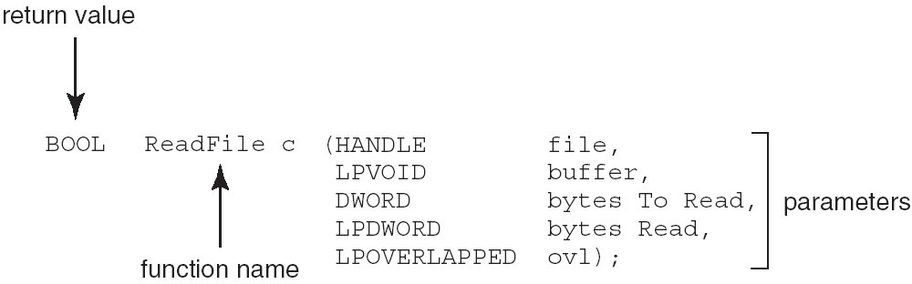
Win32 API Example
Consider the ReadFile() function in the Win32 API
A description of the parameters passed to ReadFile()
HANDLE file: File to be read
LPVOID buffer: Where the data will be read into and written from
DWORD bytesToRead: Number of bytes to be read into the buffer
LPDWORD bytesRead: Number of bytes read during the last read
LPOVERLAPPED ovl: Indicates if overlapped I/O is being used
13

Slide 14
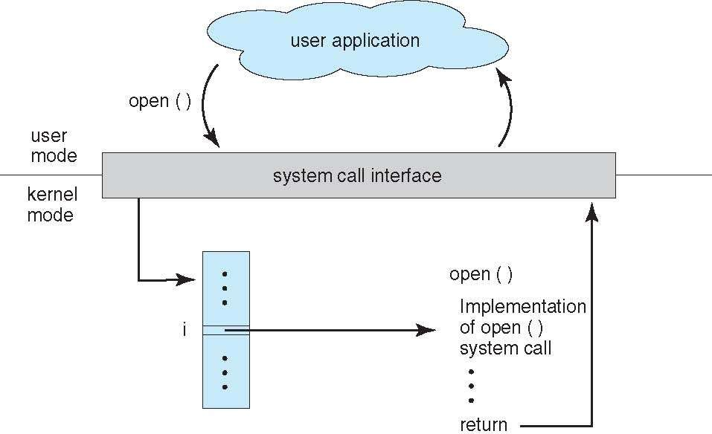
API and System Call Relationship
14

Slide 15
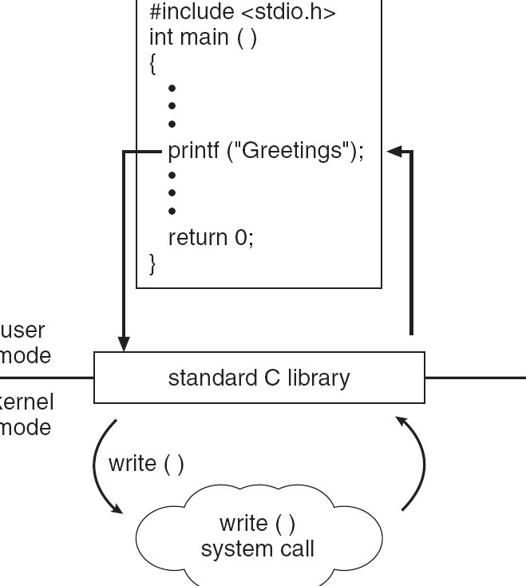
Standard C Library Example
Program invoke printf() library function, which calls write()
system call
15

Slide 16
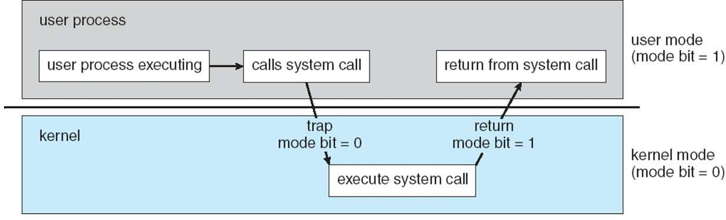
Transition From User to Kernel Mode
16

Slide 17
System Call – Parameter Passing
Three general methods used to pass parameters to the OS
Pass the parameters in registers
In some cases, may be more parameters than registers
Parameters stored in a block, or table, in memory, and address of block passed as a parameter in a register
This approach taken by Linux and Solaris
Parameters placed, or pushed, onto the stack by the program and popped off the stack by the operating system
Block and stack methods do not limit the number or length of parameters being passed
17

Slide 18
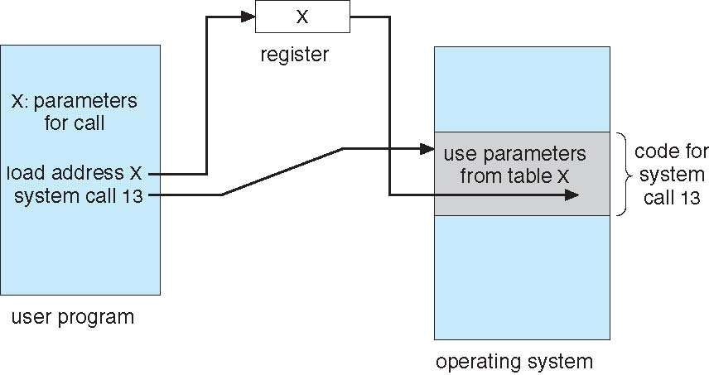
Parameter Passing via Table
18

Slide 19
Types of System Calls
Process control
End, abort
Load, execute
Create process, terminate process
Get process attributes, set process attributes
Wait for time
Wait event, signal event
Allocate and free memory
File management
create file, delete file
open, close file
read, write, reposition
get and set file attributes
19

Slide 20
Types of System Calls
Device management
Request device, release device
Read, write, reposition
Get device attributes, set device attributes
Logically attach or detach devices
Information maintenance
Get time or date, set time or date
Get system data, set system data
Get and set process, file, or device attributes
Communications
Create, delete communication connection
Send, receive messages
Transfer status information
Attach and detach remote devices
20

Slide 21
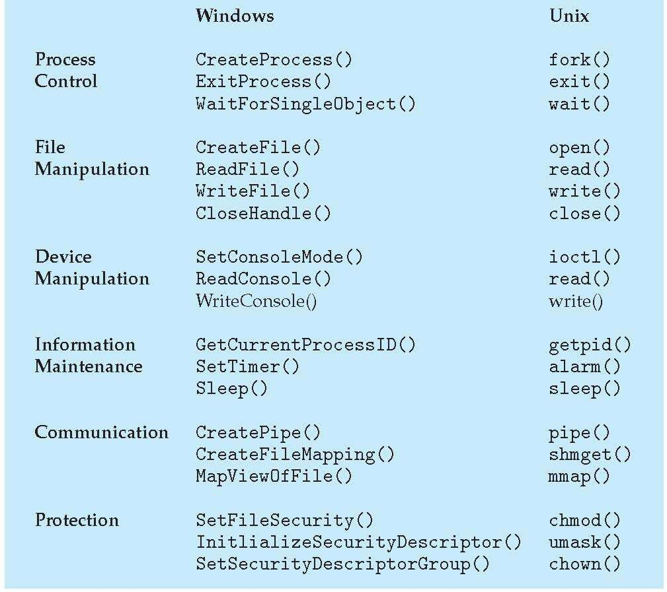
Windows and Unix System Calls – Example

Slide 22
Operating System Structure

Slide 23
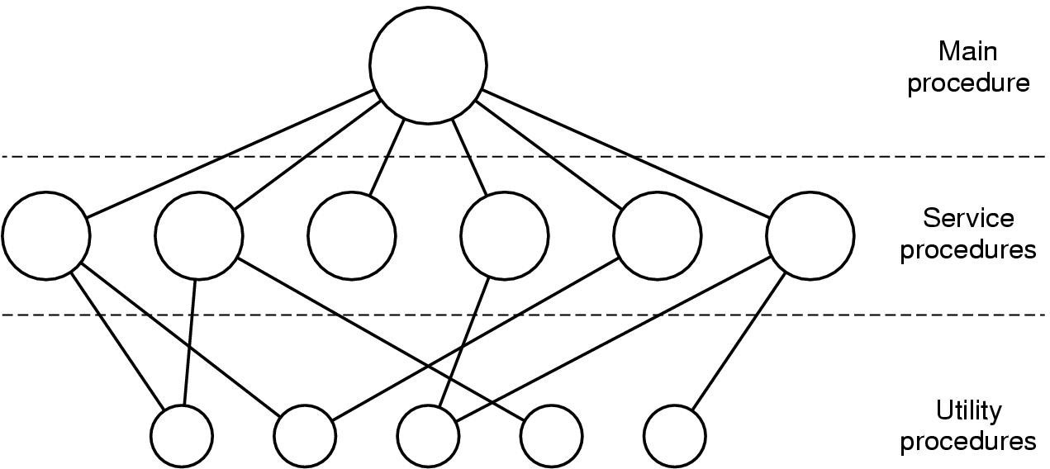
Monolithic Systems
Most operating systems have relied on a monolithic structure
OS is written as a collection of procedures
Each procedure can call any other procedure
Issues: difficult to implement and maintain

Slide 24
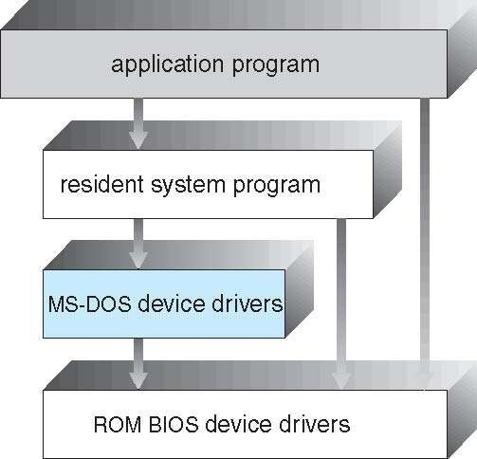
MS-DOS
Written to provide the most functionality in the least space
Not divided into modules
Although MS-DOS has some structure, its interfaces and levels of functionality are not well separated

Slide 25
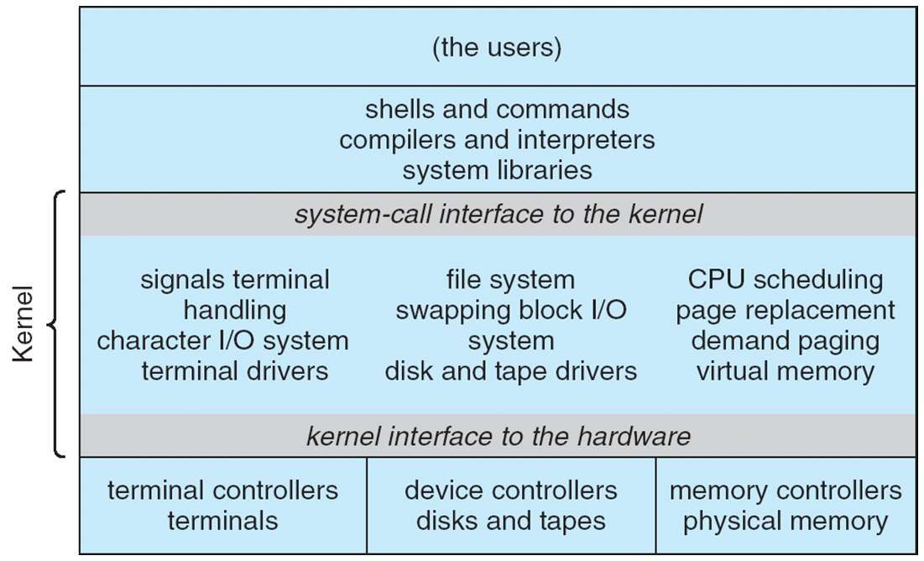
UNIX
Traditional UNIX OS consists of two separable parts
Systems programs
Kernel
Kernel consists of everything below the system-call interface and above the physical hardware

Slide 26
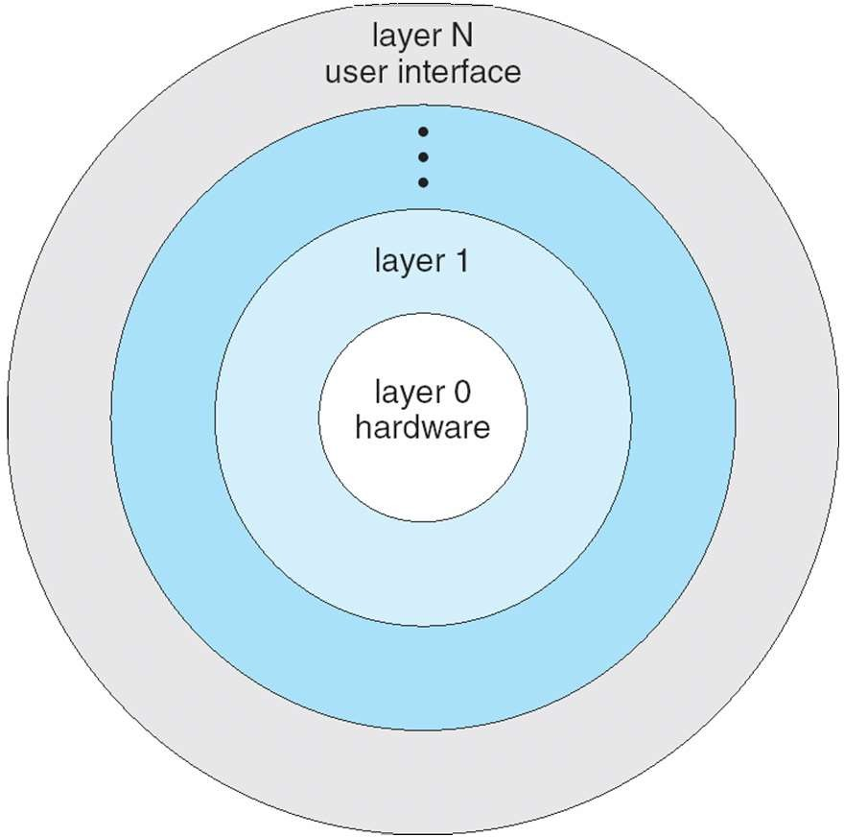
Layered Approach
Break operating system into pieces
Each layer interacts only with its lower layer
Benefits
Allows to built modular systems
Can exchange each layer
Facilitates testing
Look at each layer separately
Drawback
Difficult to define appropriate layers
Sometimes contradictory needs
Tends to be less efficient

Slide 27
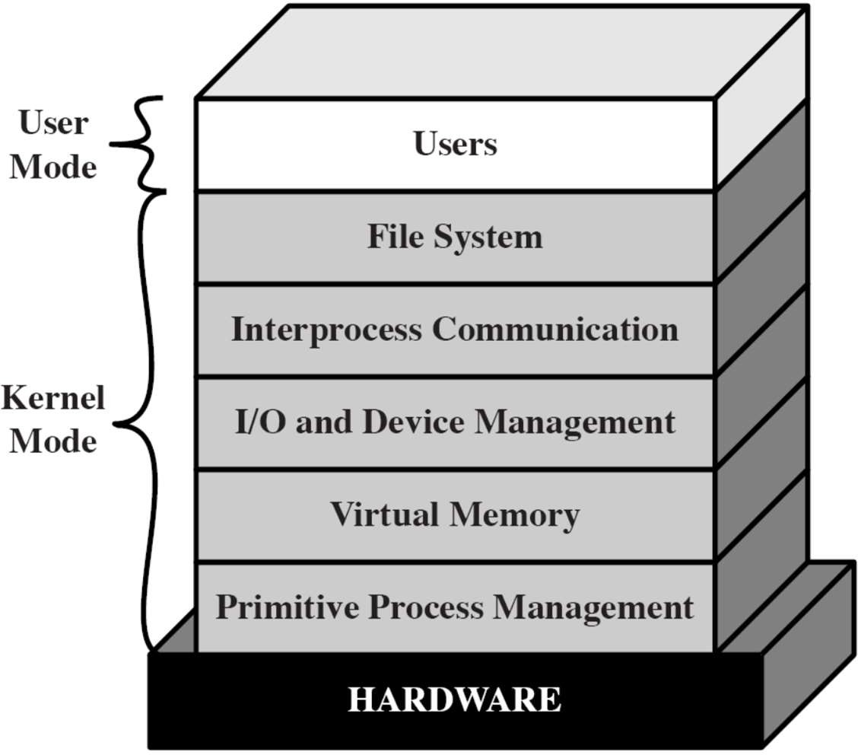
Layered Approach – Example

Slide 28
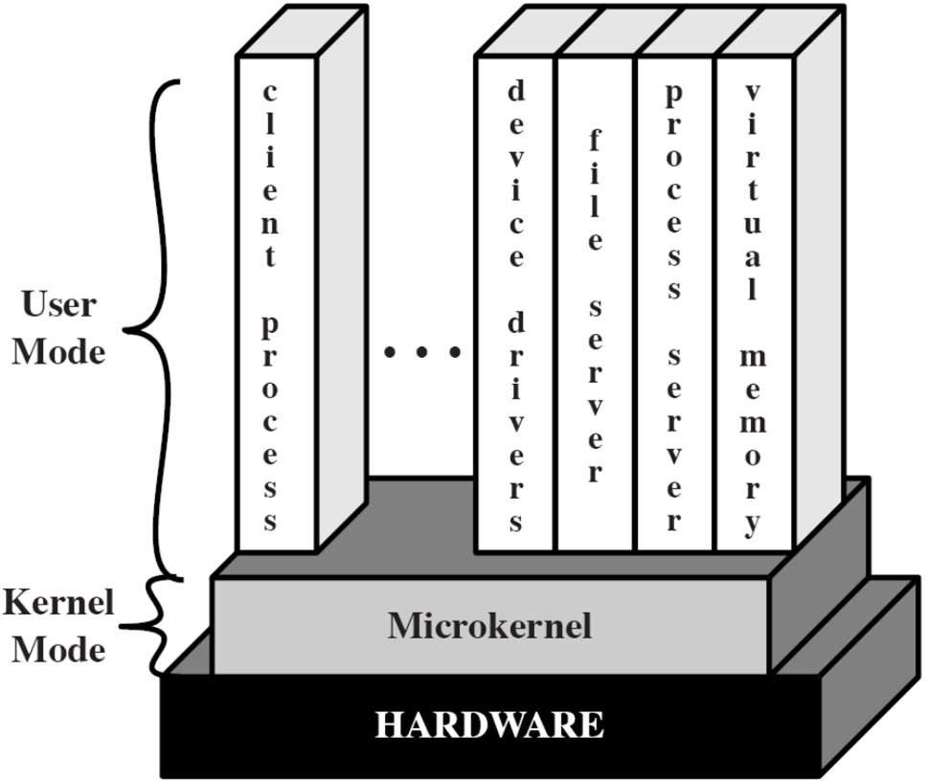
Microkernel
Small OS core – contains only essential OS functions
Low-level memory management
Process scheduling
Communication facility
Many services traditionally included in the OS kernel are now external subsystems
Device drivers, file systems, virtual memory manager, windowing system, security services
Run in user mode

Slide 29
Microkernel
Corresponds to client/server model
Communication takes place between user modules using message passing
Benefits
Easier to extend a microkernel
Easier to port the operating system to new architectures
More reliable (less code is running in kernel mode)
More secure
Detriments
Performance overhead of user space to kernel space communication

Slide 30
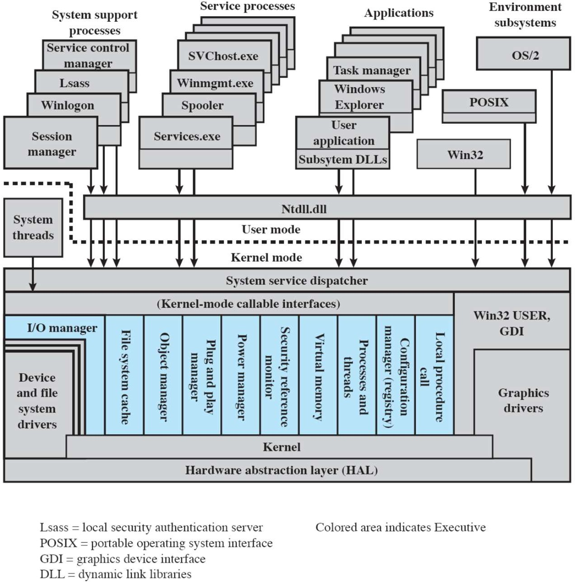
Windows 2000
Client/Server computing
Modified microkernel architecture
Not a pure microkernel: many system functions outside of the microkernel run in kernel mode
Modules can be removed, upgraded, or replaced without rewriting the entire system
1-Introduction
30

Slide 31
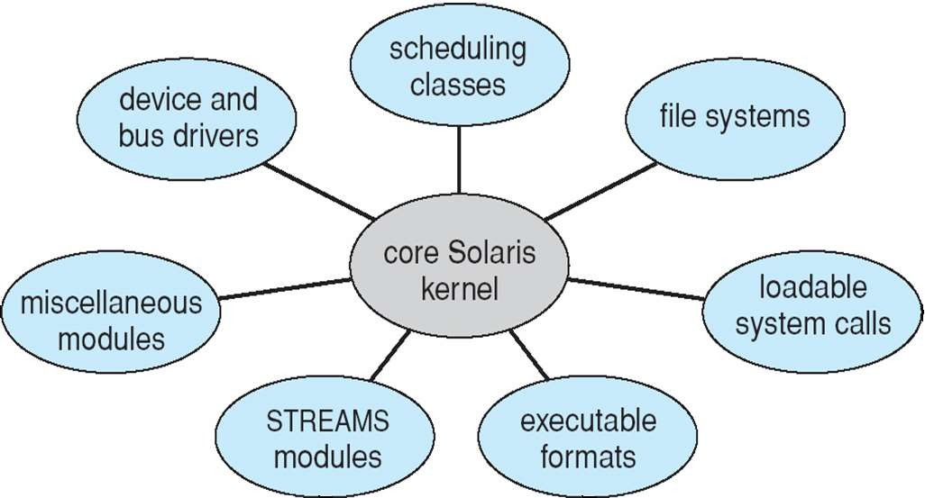
Modules
Most modern operating systems implement kernel modules
Each core component is separate
Each talks to the others over known interfaces
Each is loadable as needed within the kernel
Overall, similar to layers but with more flexible

Slide 32
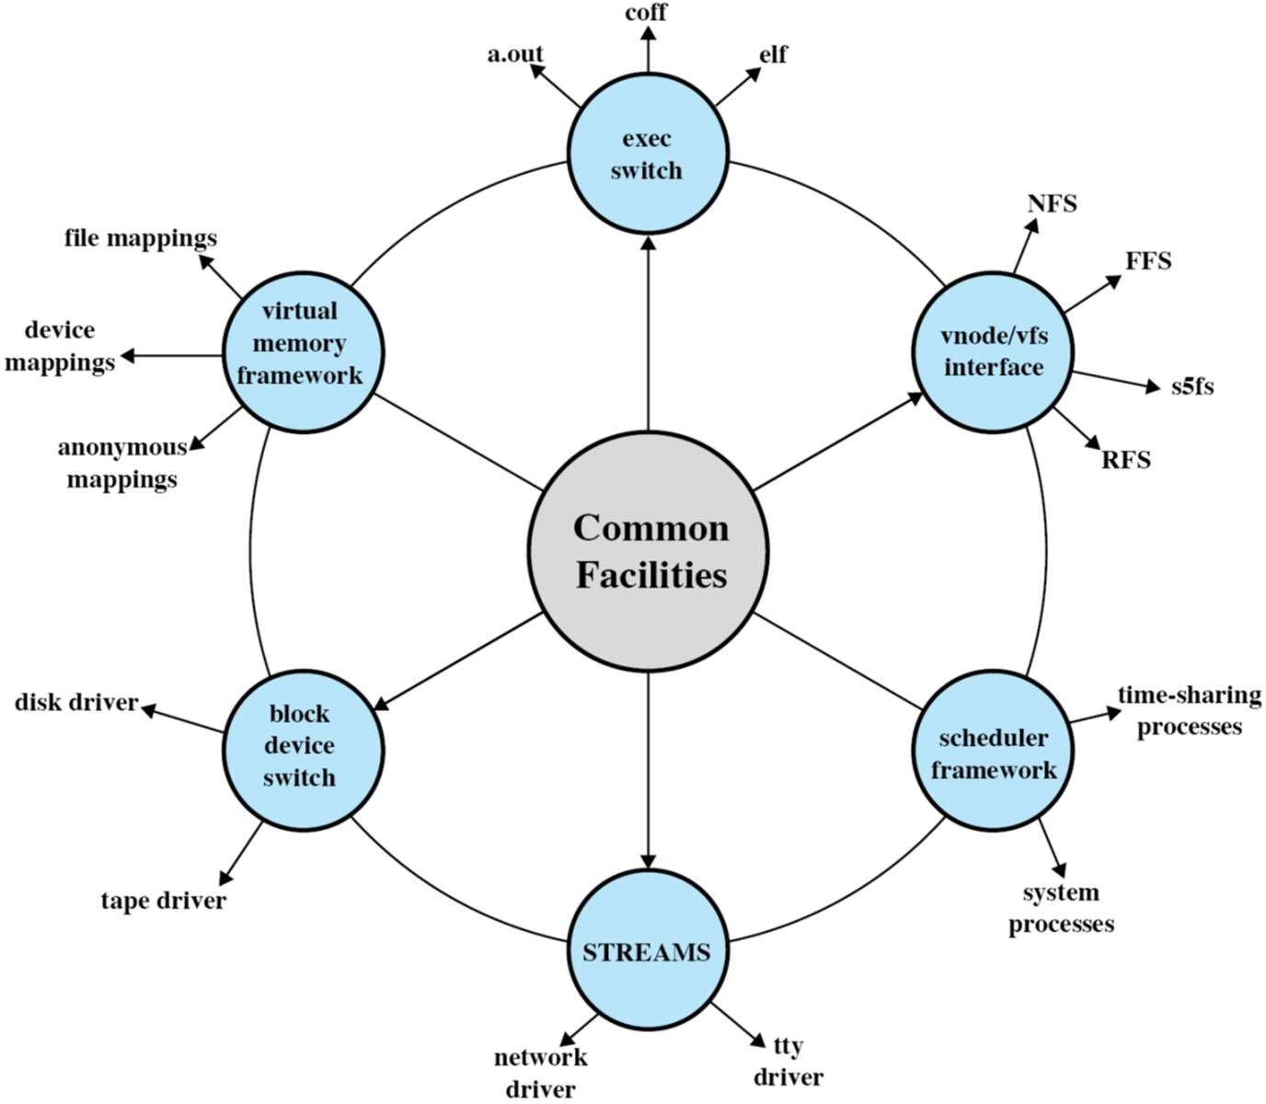
Modular Approach in Modern UNIX Instances
Kernel set of core facilities
Modules can be dynamically linked during run time
Modern Unix approaches, e.g., Solaris follow a modular organization

Slide 33
Virtual Machines
Abstract the hardware of a single computer into several different execution environment
CPU, memory, disk drives, network interface cards and so forth
Creates the illusion that each execution environment is running its own private computer
A virtual machine provides interface identical to underlying bare hardware
I.e., all devices, interrupts, memory, page tables, etc.
Virtual Machine Operating System creates illusion of multiple processors
Each capable of executing independently
No sharing, except via network protocols

Slide 34
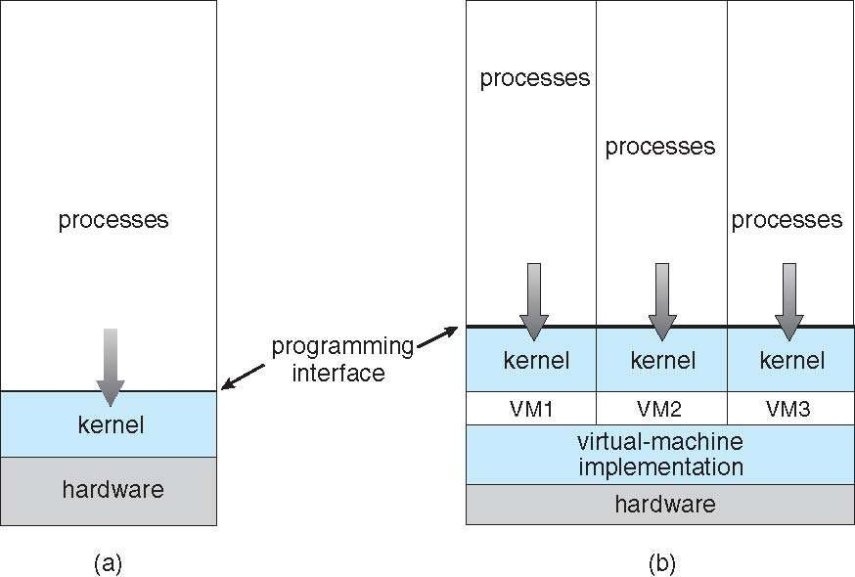
Virtual Machines
(a) Non-virtual machine (b) Virtual machine

Slide 35
Java Virtual Machine
Compiled Java programs are platform-neutral byte-codes
Executed by a Java Virtual Machine (JVM)
JVM consists of
Class loader
Class verifier
Runtime interpreter
Class verifier checks
.class file is valid Java byte code
Does not overflow or underflow the stack
Byte code does not perform illegal memory access
Just-In-Time (JIT) compilers increase performance

Slide 36
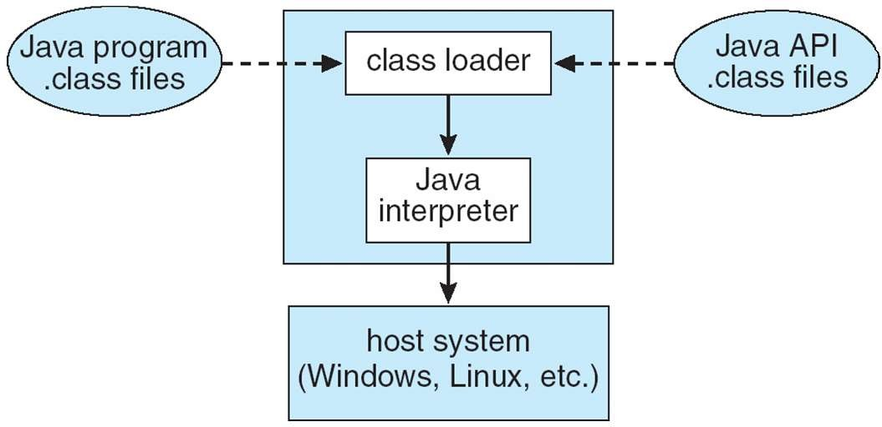
Java Virtual Machine

Slide 37

Any Question So Far?

